Slide 1
Decision Trees

Slide 2
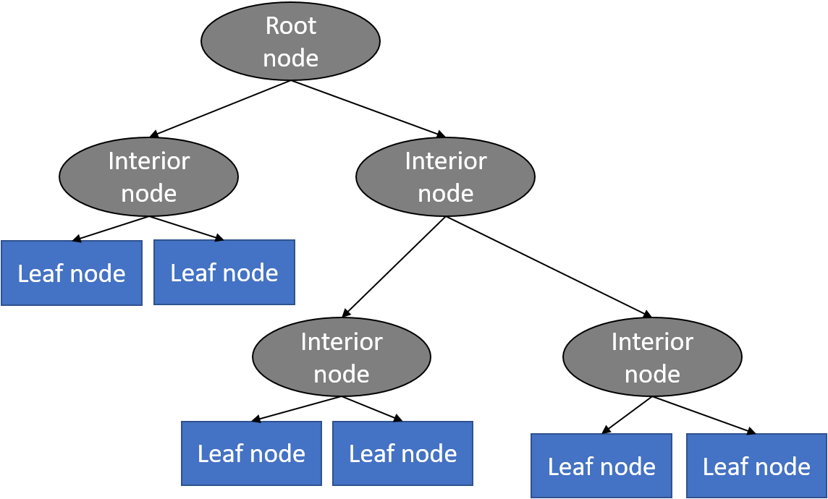
Decision Trees
Defines a tree-structured hierarchy of rules
Consists of a root node, internal nodes, and leaf nodes
Root and internal nodes contain the rules
Leaf nodes dene the predictions
Decision Tree (DT) learning is about learning such a tree from labeled training data

Slide 3
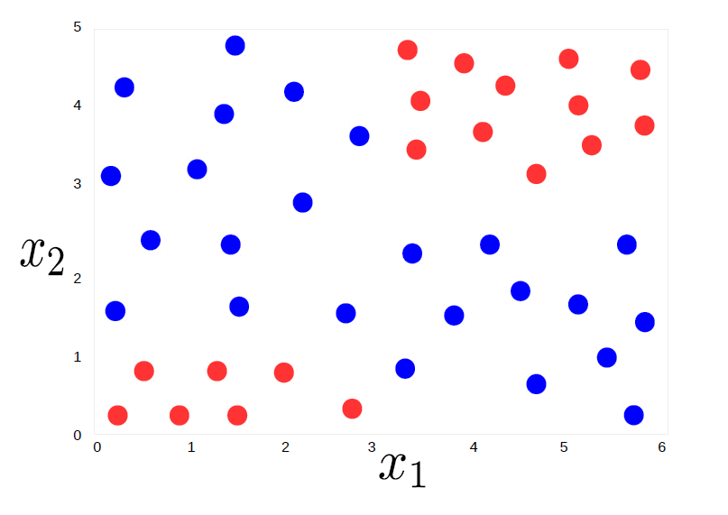
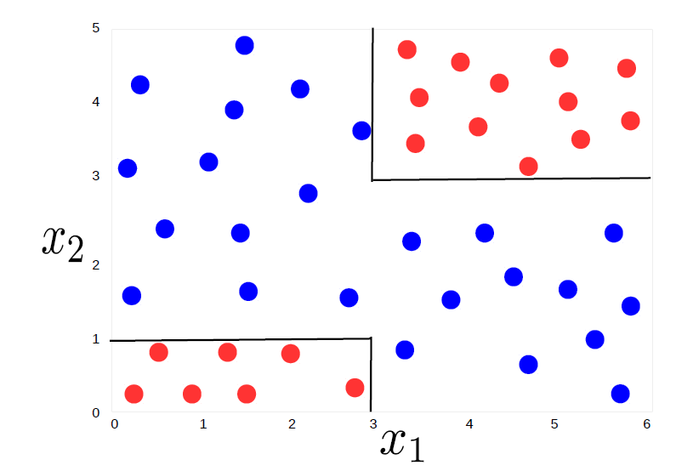
A Classification Problem
Consider binary classification. Assume training data with each input having 2 features (x1; x2)
The “expected” decision boundary given this training data.

Slide 4
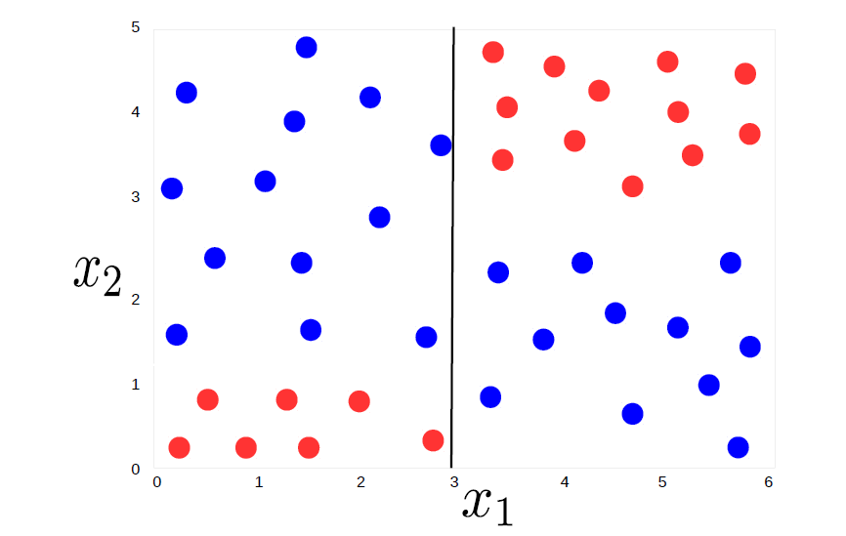
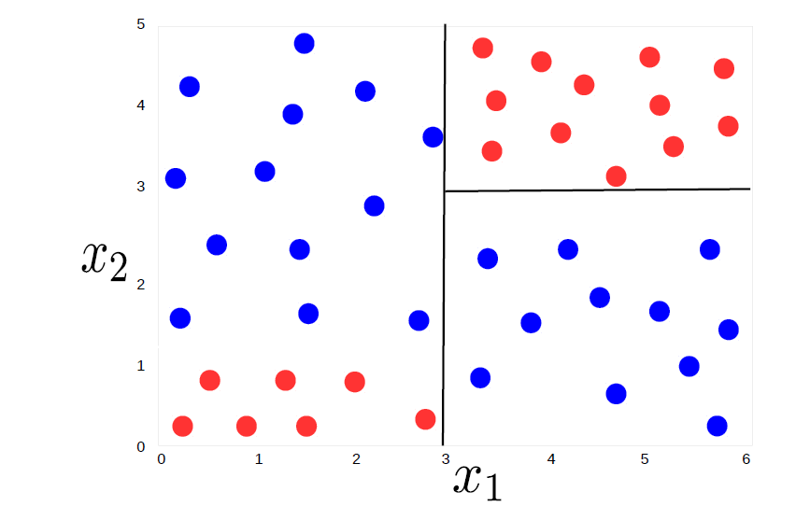
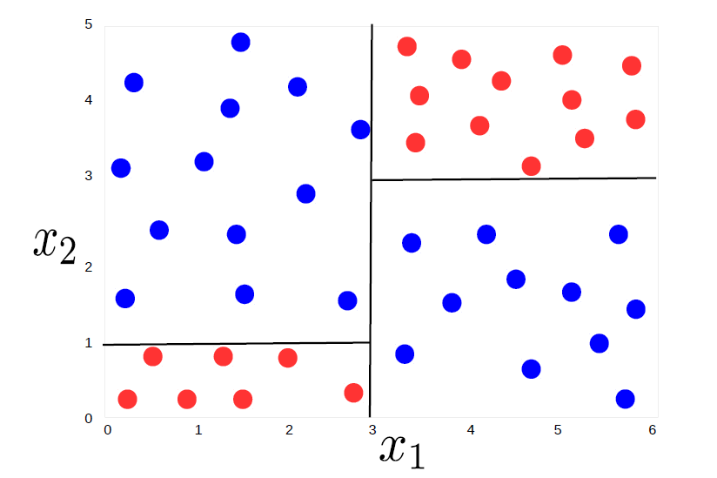
Let’s Learn how this works with the Below Example
Is x1 (feature 1) greater than 3 ?
Given x1 > 3, is feature 2 (x2) greater than 3?
Given x1 < 3, is feature 2 (x2) greater than 1?

Slide 5
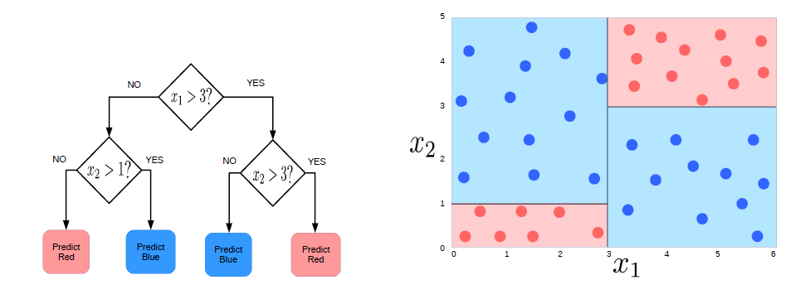
What we Learned from the example
A Decision Tree (DT) consisting of a set of rules learned from training data
These rules perform a recursive partitioning of the training data into homogeneous" regions
Homogeneous means that the outputs are same/similar for all inputs in that region
Given a new test input, we can use the DT to predict its label
A key benefit of DT: Prediction at test time is very fast (just testing a few conditions)

Slide 6
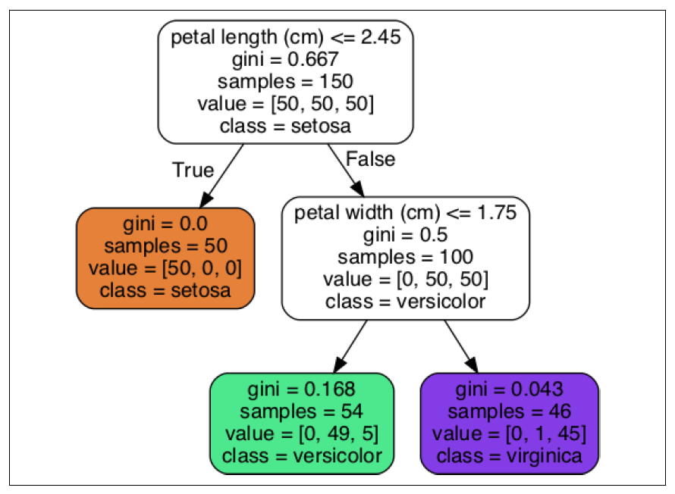

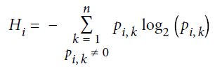
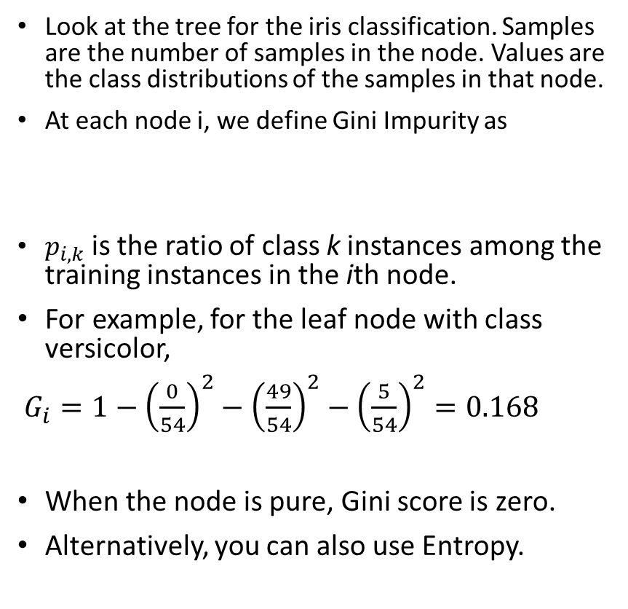
Node impurity
Look at the tree for the iris classification. Samples are the number of samples in the node. Values are the class distributions of the samples in that node.
At each node i, we define Gini Impurity as
$p_{i,k}$ is the ratio of class k instances among the training instances in the ith node.
For example, for the leaf node with class versicolor,
$G_{i}=1−{\left(\frac{0}{54}\right)}^{2}−{\left(\frac{49}{54}\right)}^{2}−{\left(\frac{5}{54}\right)}^{2}=0.168$
When the node is pure, Gini score is zero.
Alternatively, you can also use Entropy.

Slide 7
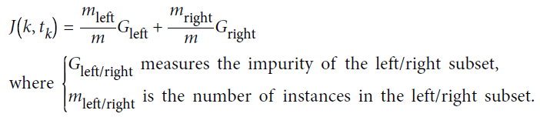
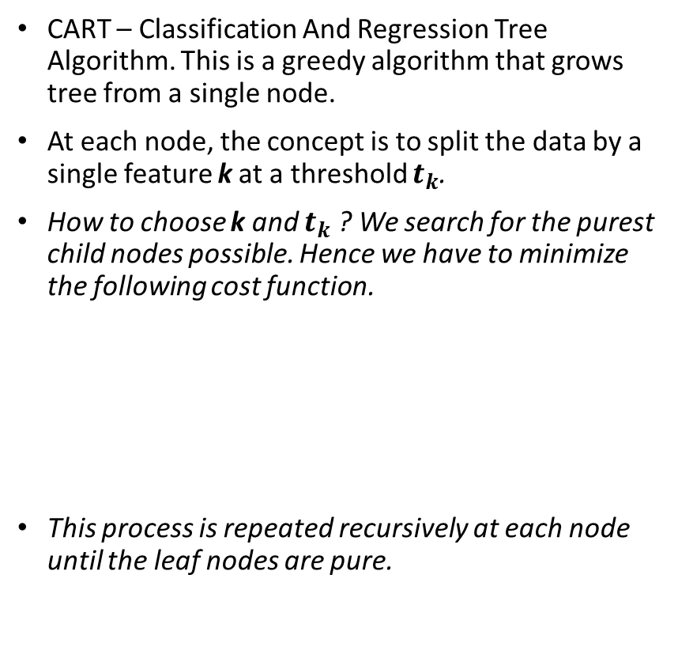
CART Algorithm
CART – Classification And Regression Tree Algorithm. This is a greedy algorithm that grows tree from a single node.
At each node, the concept is to split the data by a single feature k at a threshold $t_{k}$.
How to choose k and $t_{k}$ ? We search for the purest child nodes possible. Hence we have to minimize the following cost function.
This process is repeated recursively at each node until the leaf nodes are pure.

Slide 8
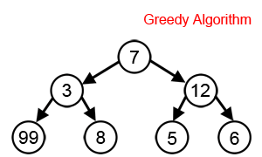
What is Greedy Search
At each step, make decision which makes greatest improvement in whatever you are trying optimize.
This type of search is likely not to be a globally optimum solution, but generally works well.
At each node of tree, make decision on which attribute best classifies training data at that point.
End result will be tree structure representing a hypothesis, which works best for the training data.

Slide 9
How to Avoid Overfitting in Decision Trees?
How can we avoid overfitting?
Stop growing when data split is not statistically significant
Acquire more training data
Remove irrelevant attributes (manual process –not always possible)
Grow full tree, then post-prune
How to select “best” tree:
Measure performance over training data
Measure performance over separate validation data set
Add complexity penalty to performance measure (heuristic: simpler is better)

Slide 10
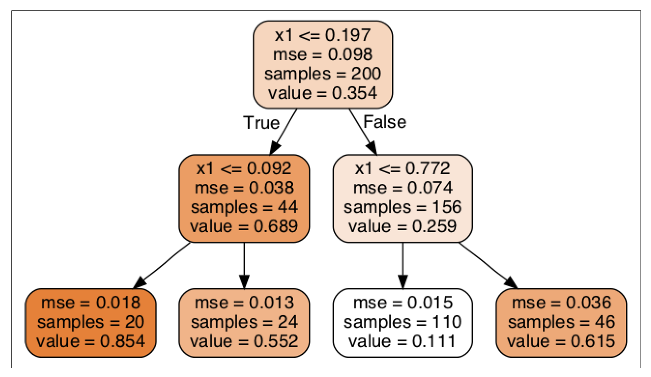
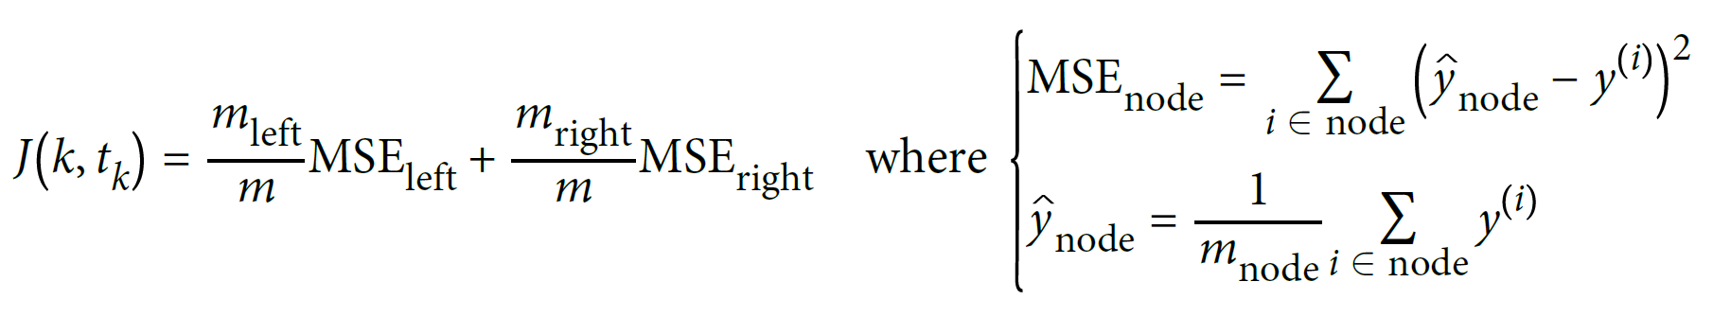
Regression
We can extend Decision trees to regression problems.
Here, the impurity is mean squared error.
At each node, all samples have the same value equal to the average of all samples in the node.

